Slide 1

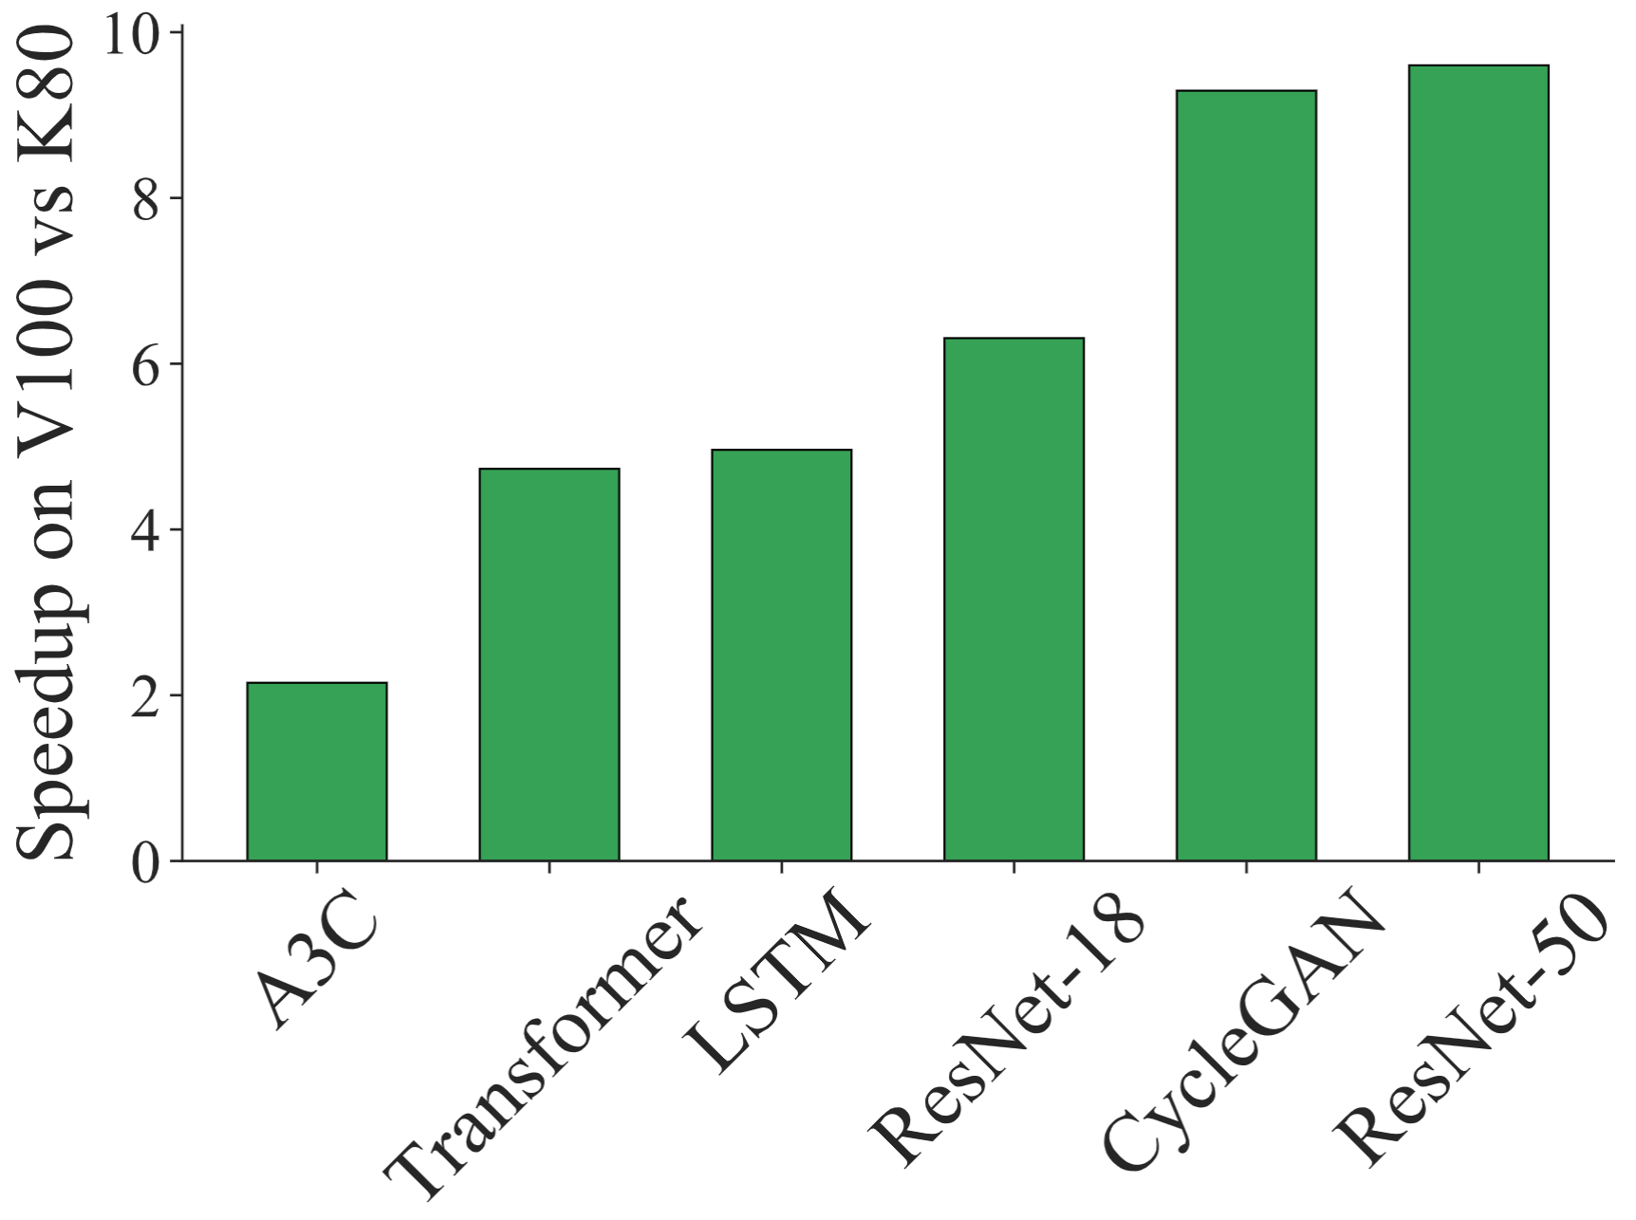
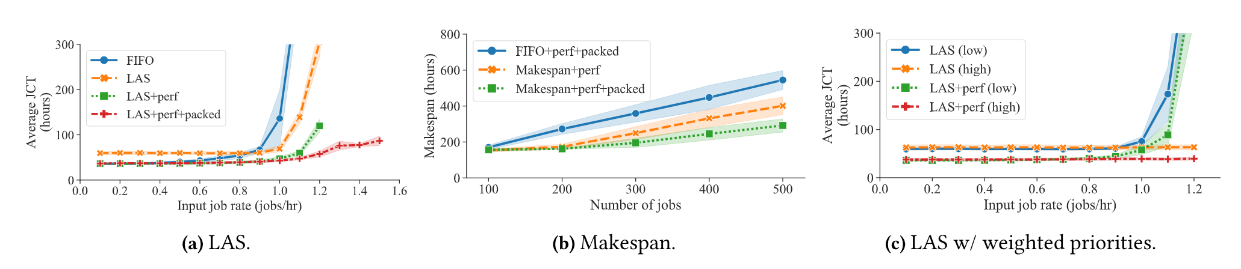
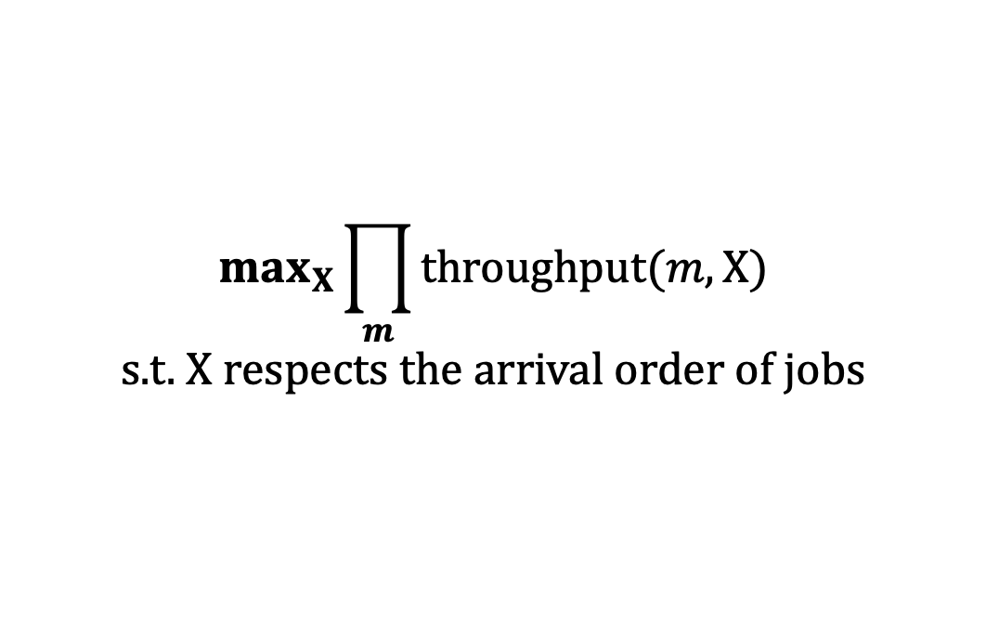

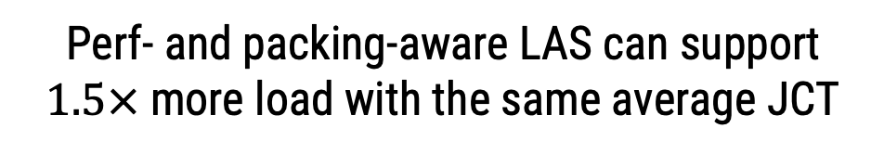

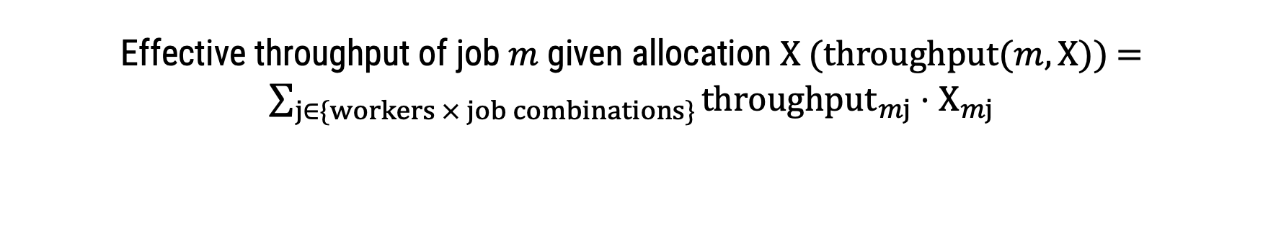
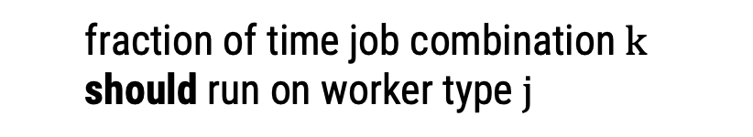
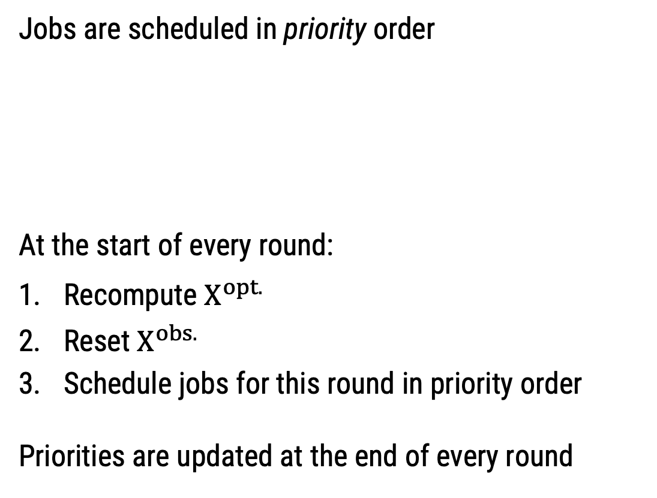
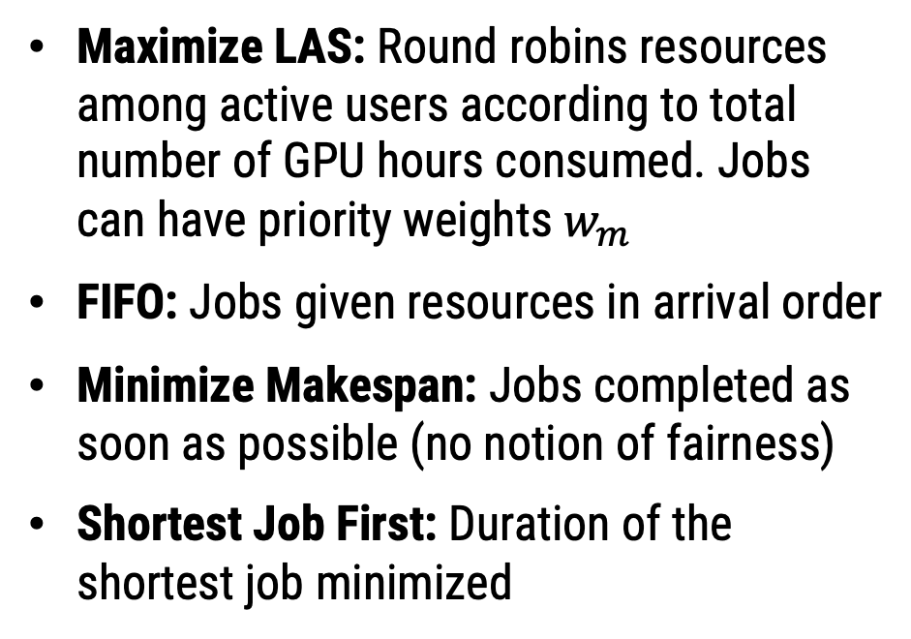
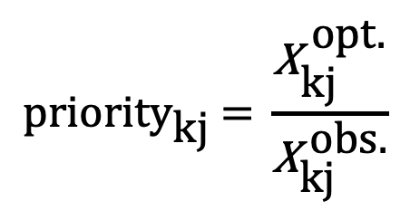
Efficient Scheduling of DNN Training on Multitenant Clusters
Deepak Narayanan*, Keshav Santhanam*, Amar Phanishayee†, Matei Zaharia*
*Stanford University, †Microsoft Research
Motivation
DNN training is expensive!
Challenges: Workload and Hardware Heterogeneity
Multitenant GPU clusters can help reduce cost
Clusters have heterogeneous compute resources (e.g., V100, P100, K80, Titan 1080Ti GPUs; TPUs)
But how do we allocate resources to the different users of the cluster who run jobs with different performance characteristics?
Different jobs experience different speedups when moving from a K80 to a V100 GPU
Different combinations of jobs experience different speedups when packed together
This work: How do we make decisions in a principled way according to a user-specified policy given workload and hardware heterogeneity?
Supported Policies
Maximize LAS: Round robins resources among active users according to total number of GPU hours consumed. Jobs can have priority weights $w_{m}$
FIFO: Jobs given resources in arrival order
Minimize Makespan: Jobs completed as soon as possible (no notion of fairness)
Shortest Job First: Duration of the shortest job minimized
Policy 1: Maximize LAS
Policy 3: Minimize Makespan
$$max_{X}{\min_{m}{\frac{throughput(m, X)}{throughput(m, X^{isolated})}⋅scale_factor_{m}}}$$
$$min_{X}{\max_{m}{ duration(m, X)}}$$
Policy 2: FIFO
Policy 4: Shortest Job First
$$max_{X}{\prod_{m}{throughput(m, X)}}$$
s.t. $X$respects the arrival order of jobs
$$min_{X}{\min_{m}{ duration(m, X)}}$$
Effective throughput of job $m$ given allocation $X$ (throughput$(m, X)$) = $\sum_{j∈\{workers × job combinations\}}{{throughput}_{mj}}⋅X_{mj}$
Scheduling Mechanism
Goal: Select jobs to run on the physical cluster to realize the theoretically optimal allocation
Challenges:
Multi-worker jobs: What if number of requested workers not available?
Job combinations: Each job should be in at most one running combination at any time
Churn: Jobs enter and exit the system; allocation needs to be recomputed
Solution: Round-based scheduling mechanism
Round 1
Round 2
Round 3
Jobs are scheduled in priority order
At the start of every round:
Recompute $X^{opt.}$
Reset $X^{obs.}$
Schedule jobs for this round in priority order
Priorities are updated at the end of every round
V100
$${\text{priority}}_{\text{kj}} \text{= }\frac{{\text{X}}_{\text{kj}}^{ \text{opt}\text{.}}}{{\text{X}}_{\text{kj}}^{ \text{obs}\text{.}}}$$
fraction of time job combination k should run on worker type $j$
fraction of time job combination k actually run on worker type j
P100
If active jobs change (jobs finish or new jobs arrive)
K80
Time
Evaluation
Perf- and packing-aware LAS can support $1.5×$ more load with the same average JCT
Perf- and packing-aware makespan policies can reduce makespan by $2×$
With weighted jobs, perf-aware LAS can reduce the JCT for both high- and low-priority jobs

